Slide 1
Research Summarization
Lan Zhang

Slide 2
Master Dissertation:
Understanding the Latent Space in
Variational Autoencoders

Slide 3
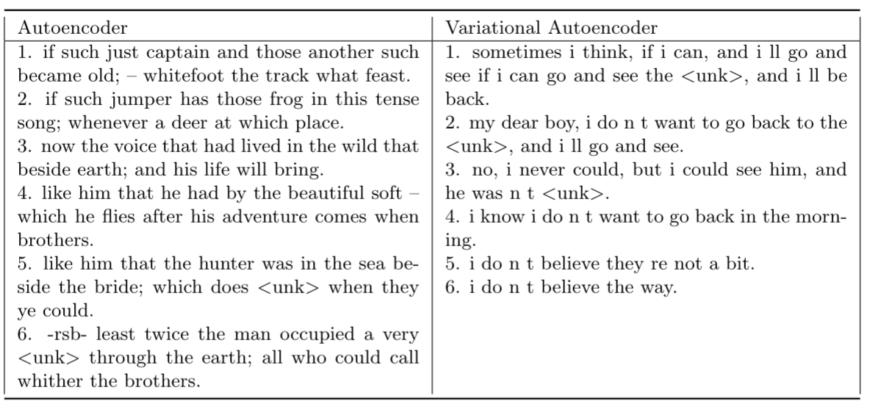
Motivation
Table 1. Homotopies in Autoencoder and Variational Autoencoder.

Slide 4
Motivation
How VAEs choose representation of the data and how VAEs capture the syntactic and semantic information.
Although the performance is the mainly consideration, the interpretability of model is also important.
Interpret Variational Autoencoders from understanding the latent space.

Slide 5
Objective Function
VAE has an information-theoretic interpretation, where the KL term is seen as the amount of information transmitted from a sender (encoder) to a receiver (decoder) via the message (latent code) (Alemi et al., 2018). We use the objective function:
with 𝛽 = 1.

Slide 6
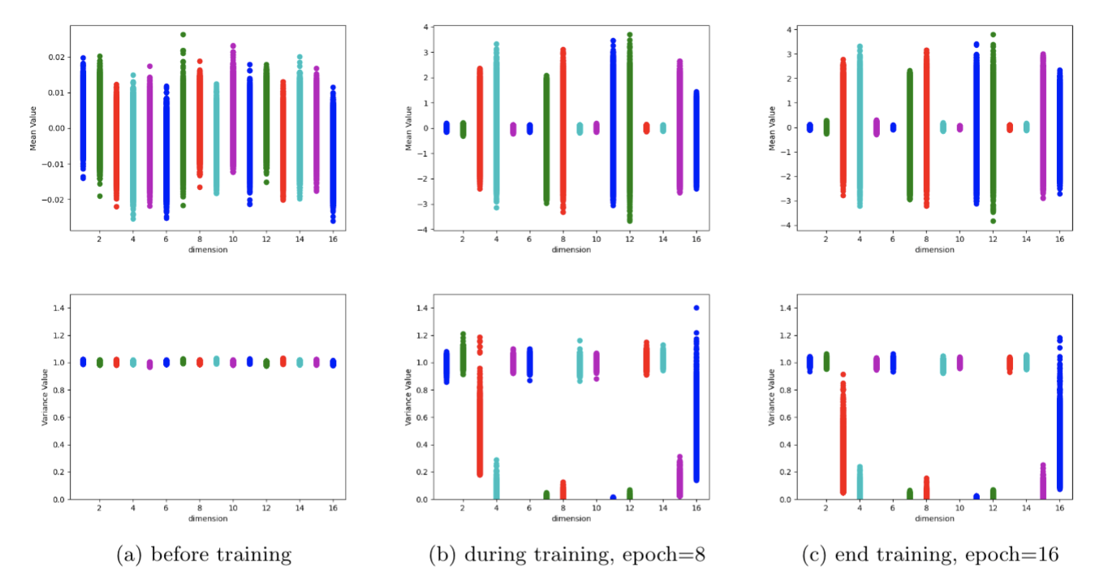
Changes of posterior distributions on validation set
Observation
Figure 4. C=15, dim=16, smallest reconstruction loss model.

Slide 7
Signal Dimensions and Noise Dimensions
The dimensions of latent space are divided into noise dimensions and signal dimensions.
Signal dimensions and noise dimensions can be classified by setting a threshold on the variance of posteriors in contrast to active units (Burda et al., 2016) which judge dimension activation on mean.

Slide 8
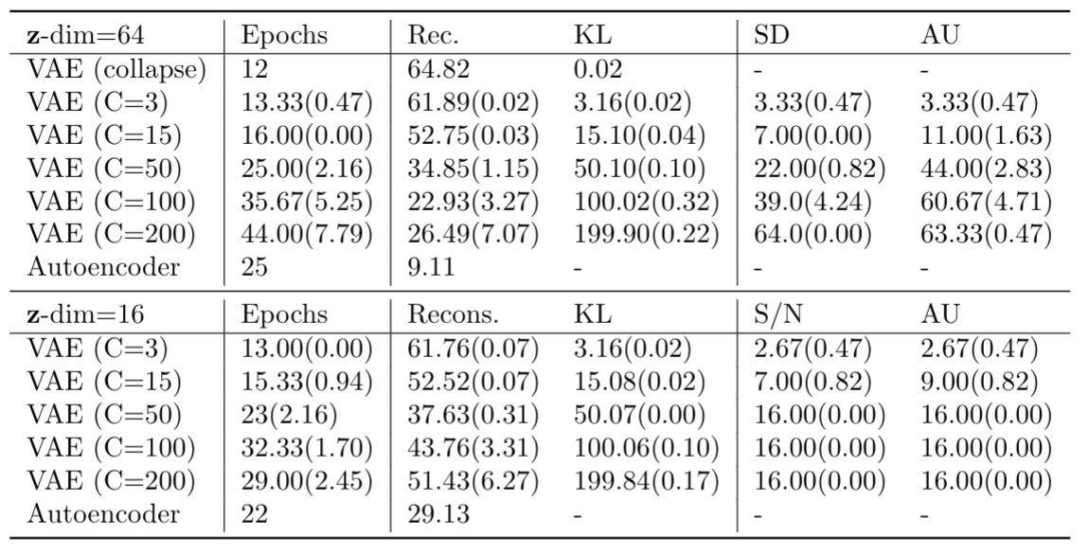
Loss Results
Table 2: Losses on CBT Corpora (test set). Numbers are averaged over the number of sentences.

Slide 9
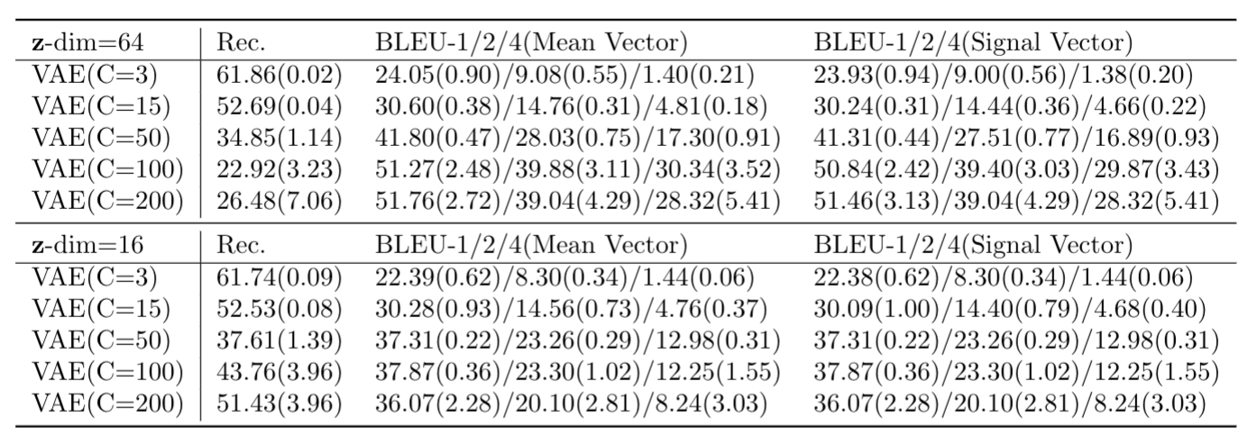
Reconstruction Results
Table 3: BLEU scores of using mean and signal vector (test set).

Slide 10
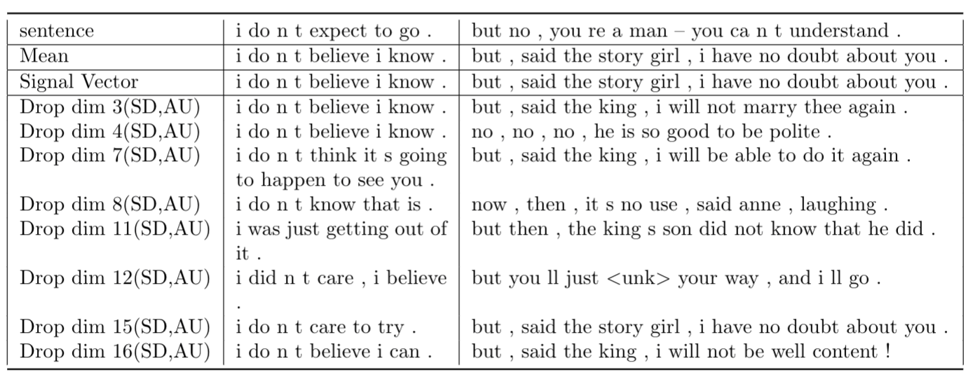
Sample Sentences from Test Set
Table 4: Drop 1 signal dimensions at a time (C=15,dim=16, best run).

Slide 11
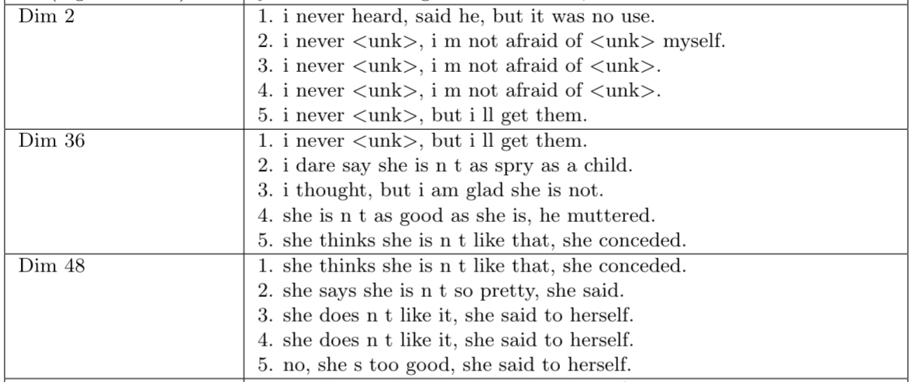
Dimension-wise Homotopy
Table 5: Dimension-Wise Homotopy (C=15,dim=16, best run).

Slide 12
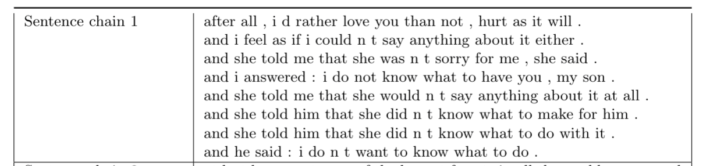
Feed the encoder with a sentence and keep feeding the encoder with the new reconstructed sentences and obtain a series of sentences.
Sentence Chain
Table 6: Sentence Chain (C=15,dim=16, best run).

Slide 13
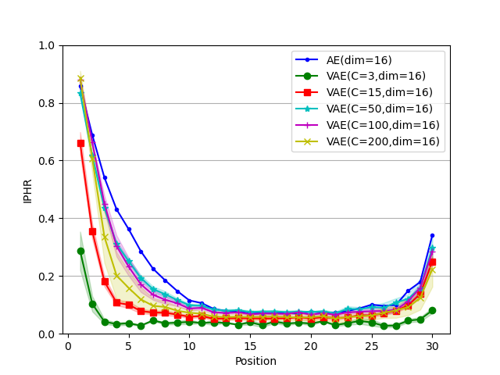
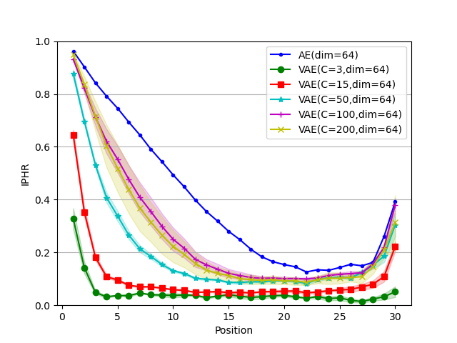
Position Correctness
Figure 5: Individual Position Hit Rate.

Slide 14
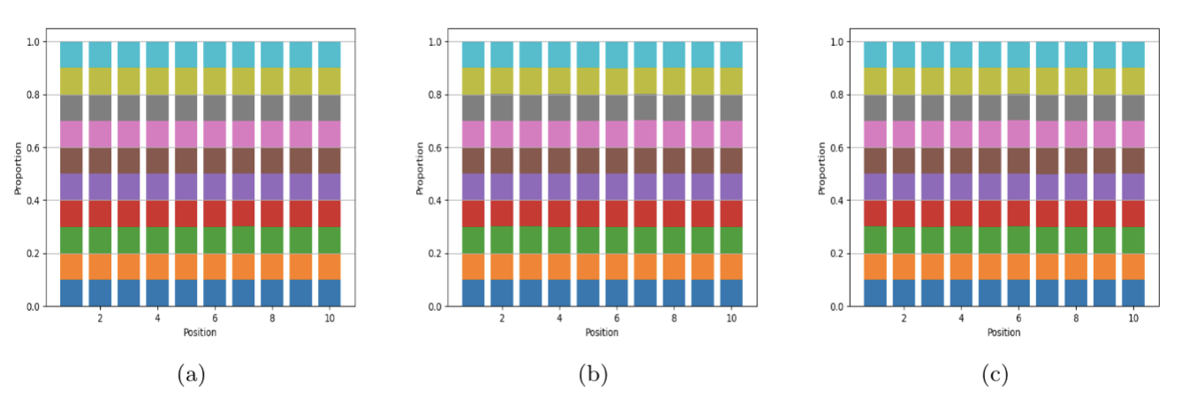
10 words, every word in the vocabulary appears once and only once.
Toy dataset 1
Figure 6: The proportion of words at each position. Each color represents a word
(a) on train set (b) on validation set (c) on test set.

Slide 15
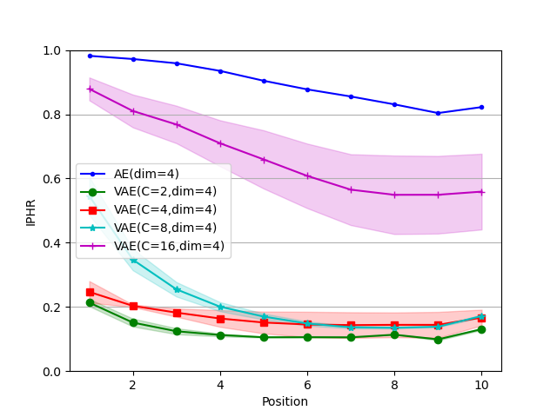
Toy dataset 1 Results
Figure 7: Individual Position Hit Rate

Slide 16
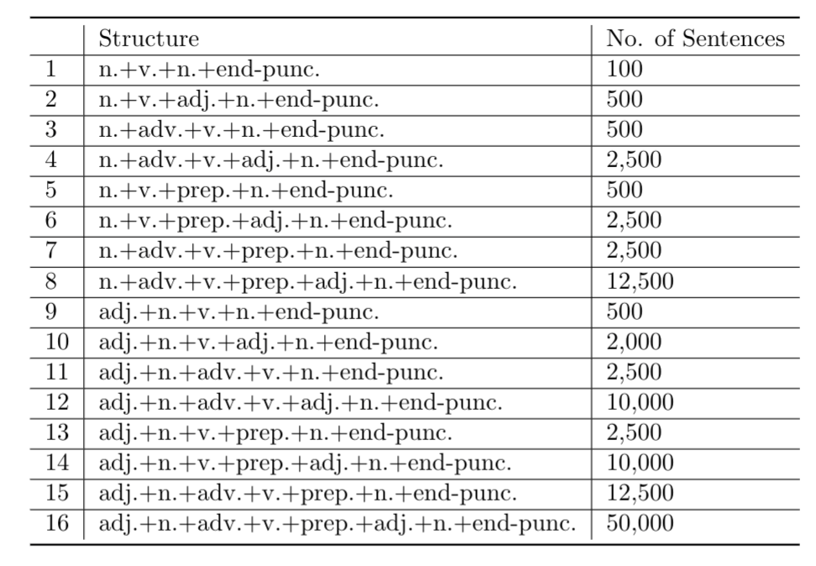
Toy dataset 2
Table 8: Simple sentences structures.

Slide 17
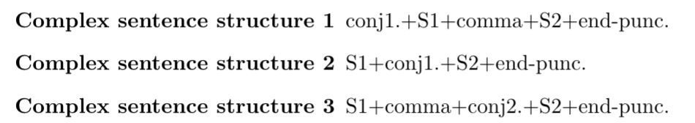
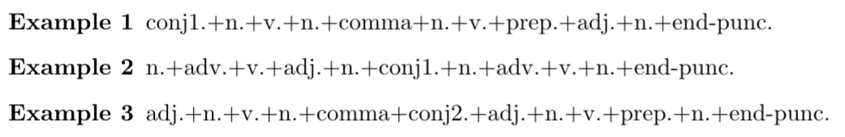
Toy dataset 2
Figure 8: Complex sentences structures.
Figure 9: Examples.

Slide 18
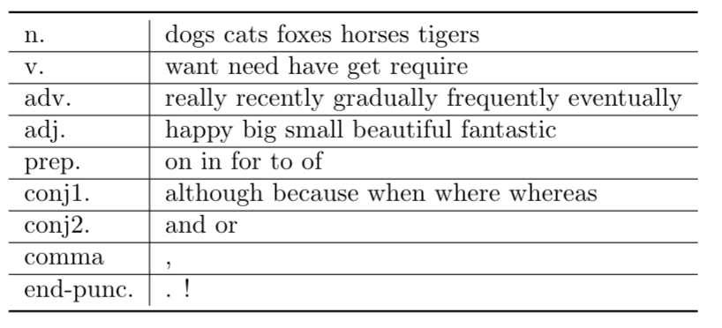
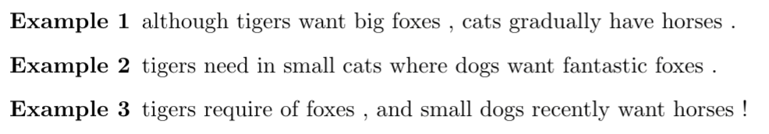
Toy dataset 2
Figure 10: Words.
Figure 11: Examples.

Slide 19
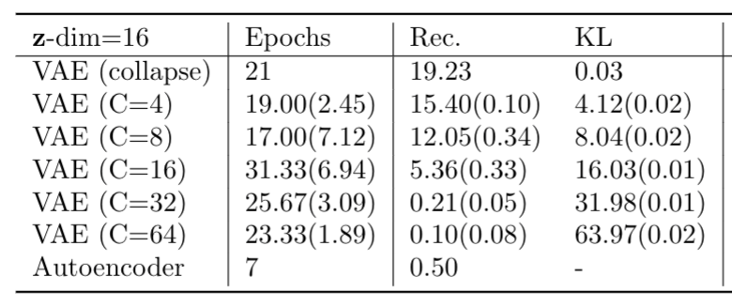
Results
Table 9: Losses on Toy Dataset 2.

Slide 20
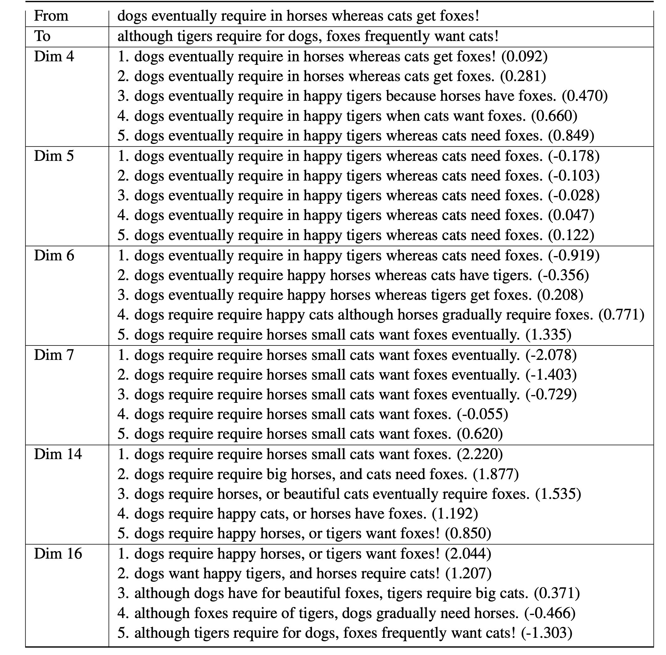
Results

Slide 21
RepL4NLP2021:
Unsupervised Representation Disentanglement of Text: An Evaluation on Synthetic Datasets

Slide 22
Motivation of Disentanglement
Example:
Lan is a student from China. Tom is a teacher in America.
Name
Occupation
Place
If we have a disentanglement representation (z1,z2,z3) such that each dimension is only corresponding to one factor, we can:
achieve interpretability;
have controlled generation by controlling representations.
How to (1) learn such representations and (2) evaluate disentanglement?

Slide 23
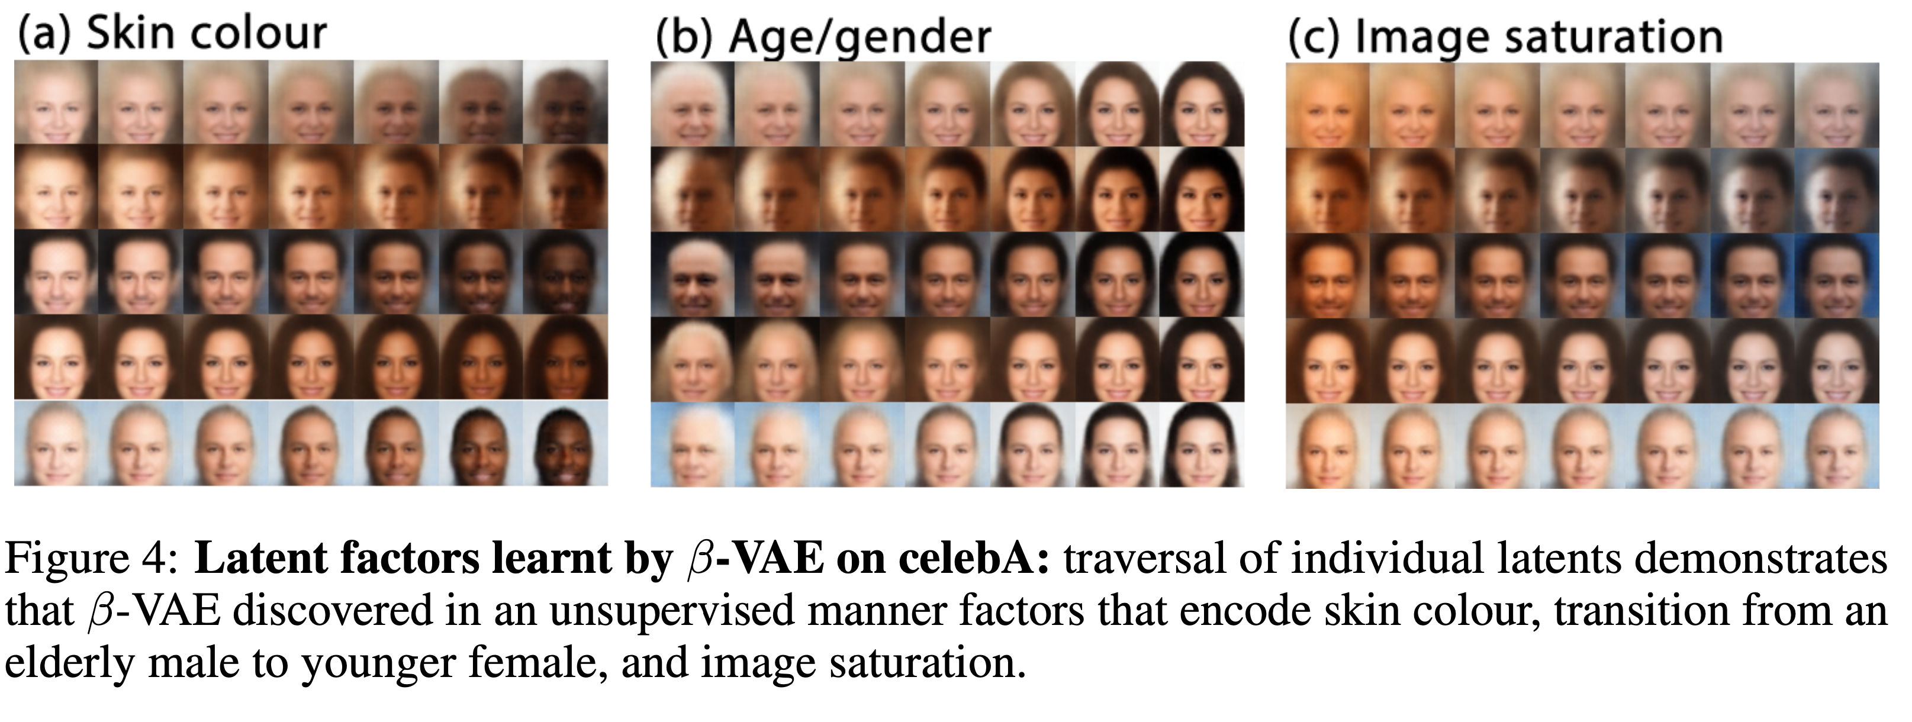
Disentanglement in Image Domain
In image domain, VAE-based model such as Beta-VAE is employed to learn disentangled representations in an unsupervised manner, and evaluation is done on datasets with known factors of variation.

Slide 24
A Difficult Task in Text Domain
From the training strategy side, VAE-based models for text usually have autoregressive decoders with teacher-force training, which makes the reconstruction depend on not only the latent code and potentially discourage disentanglement.
From the evaluation side, most existing real text datasets do not have explicit factors of variation.
From the model side, since we are unable to evaluate disentanglement, it is hare to compare and develop appropriate architectures and objective functions to encourage disentanglement.
Evaluation is of high priority.

Slide 25
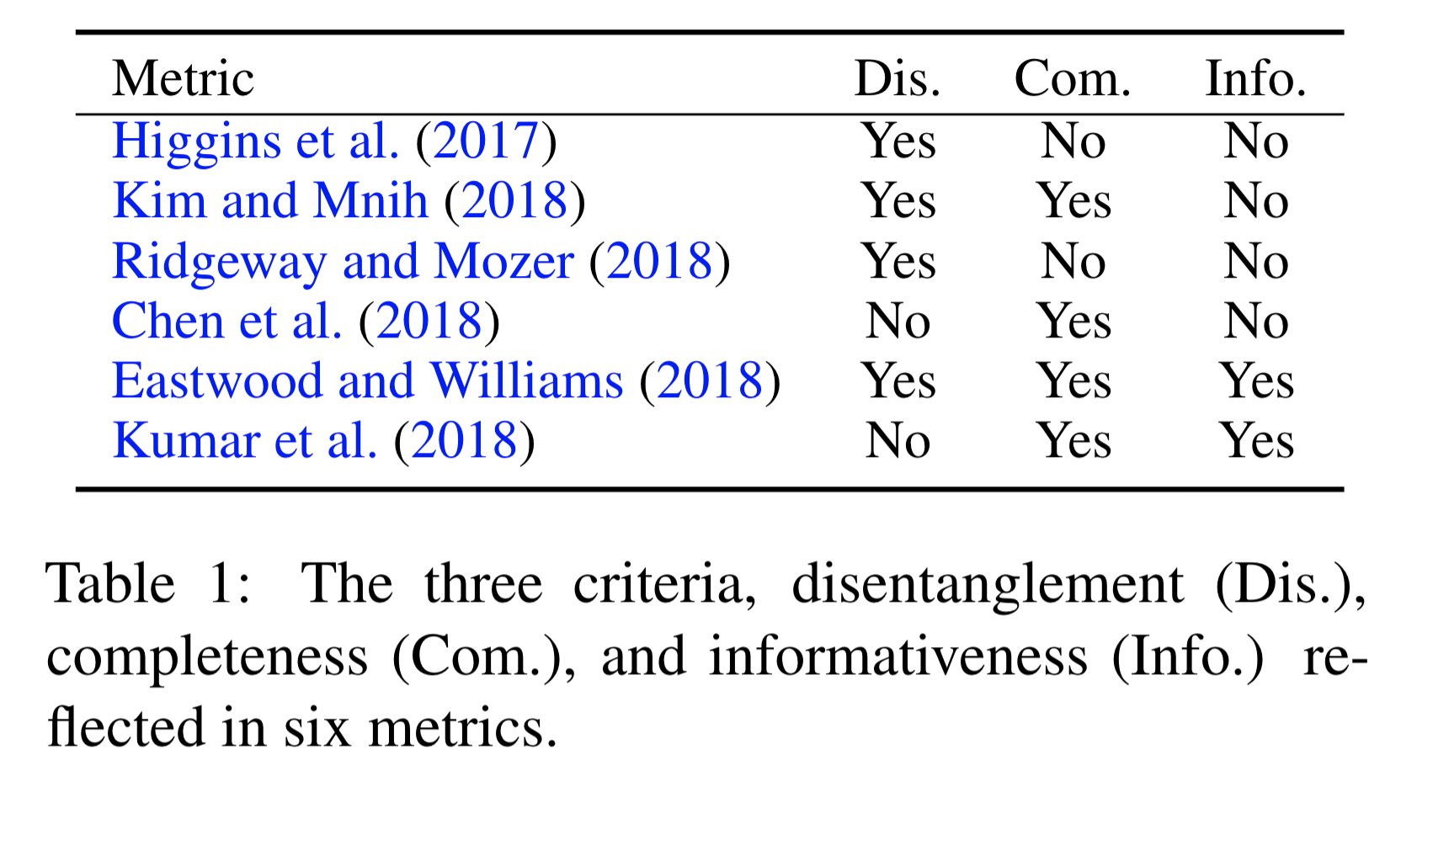
Synthetic Datasets and Disentanglement Metrics
Following the common practice of designing generative synthetic datasets in image domain, we propose two artificial text datasets with know generative factors: YNOC dataset and POS dataset.
With these two datasets, we implement six disentanglement metrics from image domain.

Slide 26
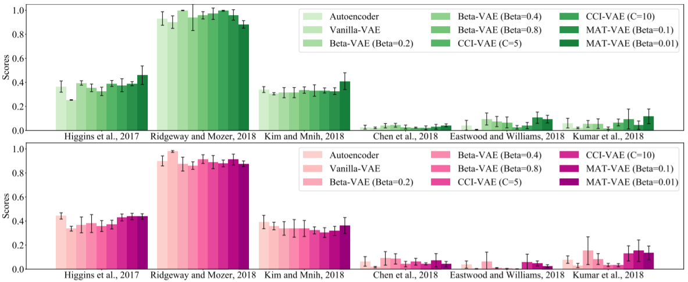
Observation: The difference between means of each disentanglement score on various models is relatively small, and due to large standard deviation on metrics, it is difficult to single out a superior model. More consistent and text-specific metrics need to be discovered.

Slide 27
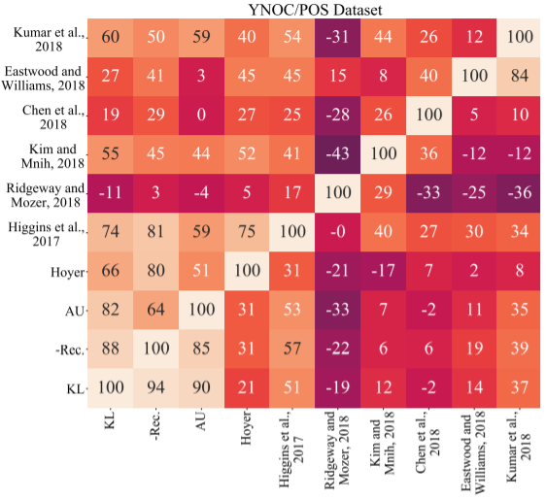
Correlation
Hoyer is a measurement of sparsity level.
Observation: Higgins et al. (2017) has strong correlation with Hoyer, AU, -Rec, KL, and the highest level of agreement with other metrics.

Slide 28
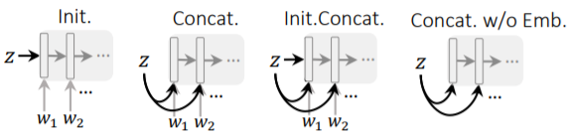
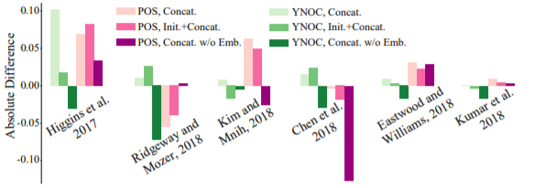
Different coupling strategies
Observation: In general, using concatenation can bring a large improvement in disentanglement. Using both initialization and concatenation do not lead to a better result.

Slide 29
Experimental Findings
Inconsistency of disentanglement metrics, showing different metrics (alone) lead to different conclusions.
VAE indeed has shown better disentanglement than AEs.
Even on simple enough dataset (YNOC), disentanglement is difficult to achieve for some popular VAEs such as Beta-VAE and CCI-VAE.
Sequential processing of data injects an unwanted positional bias towards disentangling the generative factors.

Slide 30
ACL2022:
On the Effect of Isotropy on VAE Representations of Text

Slide 31
Motivation
A non-collapsed VAE utilises the representation space sub-optimally (Prokhorov et al., 2019; He et al., 2019; Burda et al., 2016), as very commonly the learned representations do not fully utilise the latent space to encode information.
We assume this is due to a geometric property of learned representations, anisotropy (Ethayarajh, 2019), indicating a sub-optimal property where the learned embeddings only utilise a small subset of the representation space.
We inject isotropy in the latent space of VAEs by tying the variances of diagonal Gaussian posterior to mitigate this issue.

Slide 32
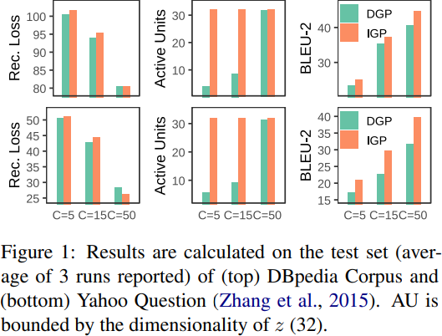
Experiment—Basic Results
KL-divergence in all cases matches the set target C. The C constraint can effectively control the KL-divergence to the set level.
The reconstruction loss generally drops with the increase of C.
IGP can activate all dimensions. This translates into IGP reaching a significantly higher BLEU.

Slide 33
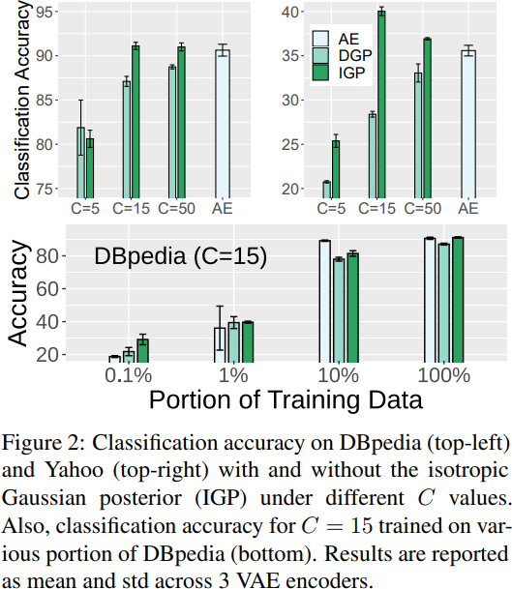
Experiment—Classification
Overall, the representations of most VAEs with IGP lead to a significant improvement of classification accuracy compared to vanilla VAEs.
DGP does not perform as good as AEs regardless of C choice, whereas IGP (C= 15, 50) achieve similar and better classification accuracy.
In the few-shot setting, accuracy scores with IGP exhibits a better sample efficiency.

Slide 34
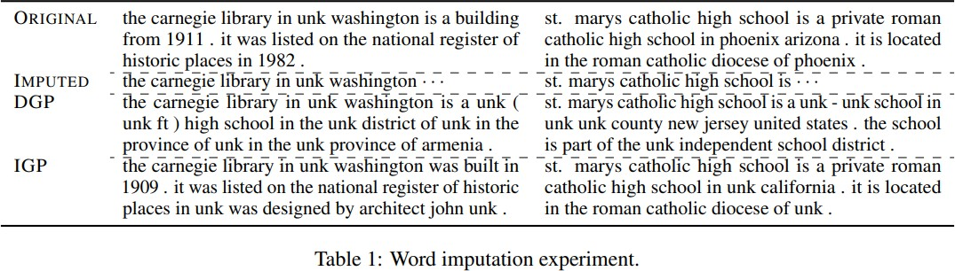
Experiment—Generation
IGP successfully recovers the type of the mentioned object and completes the imputed sentence with a similar structure, whereas DGP fails to do so.

Slide 35
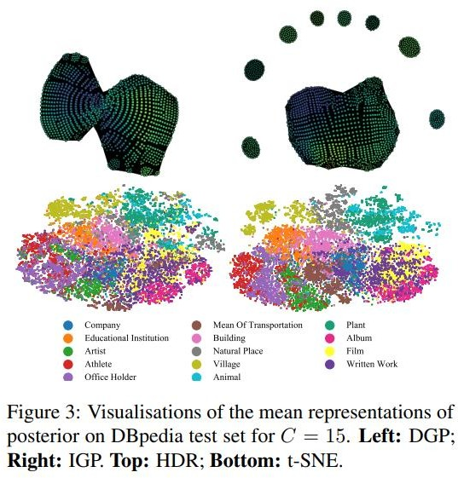
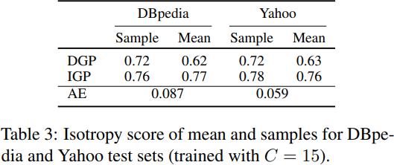
Experiment—Properties of Representations
Compared to DGP, IGP has a significantly larger isotropy score on both means and samples.
Given that dimensions are independently modeled via univariate Gaussians, both VAEs outperform the Autoencoder counterparts.

Slide 36
Conclusion
The injection of isotropy addressed a sub-optimal behaviour of VAEs by activating more dimensions of the representation and encouraging a more discriminative latent space.
VAE trained with IGP is more capable at maintaining semantic cohesiveness.
The representation utilization achieved by IGP has the potential to be exploited towards representational properties such as disentanglement.

